Slide 1
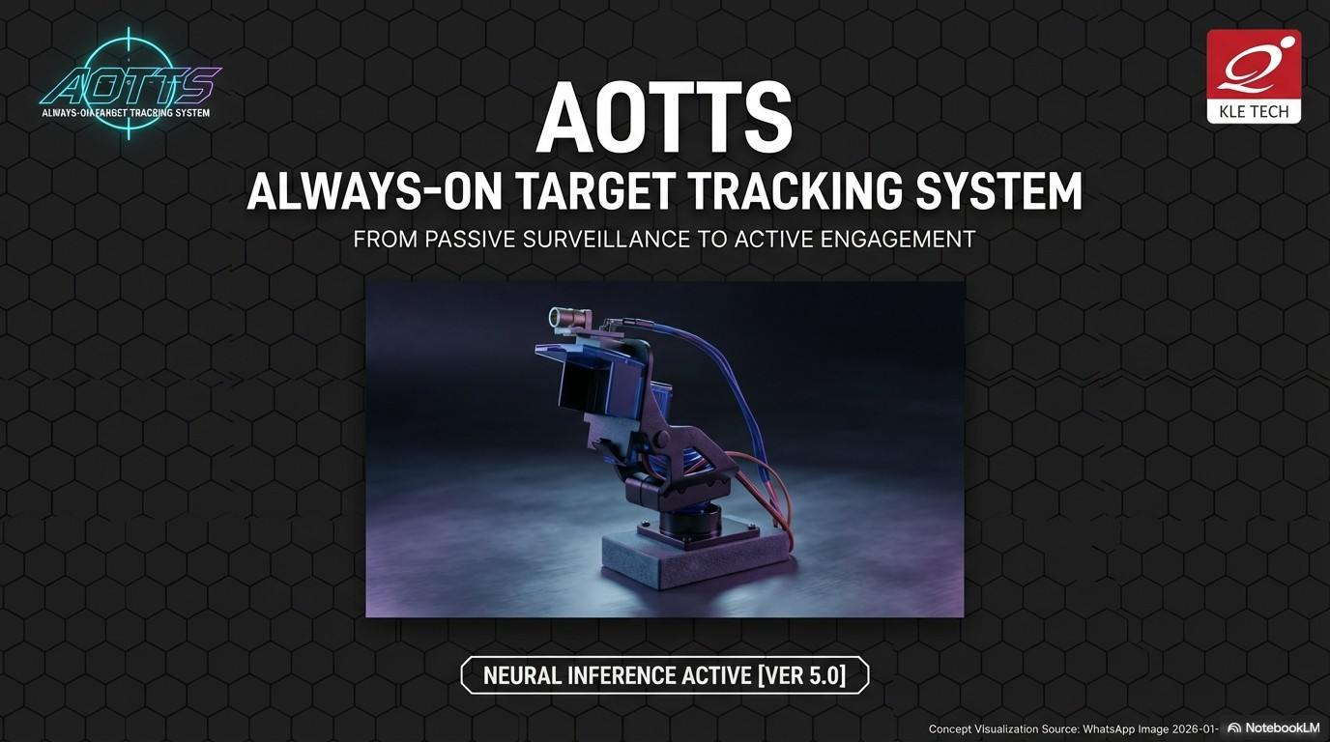


Slide 2



COURSE: EMBEDDED SYSTEMS & IOT
COURSE CODE: 25ECAC206
PROJECT : AOTTS – ALWAYS ON TARGET TRACKING SYSTEM
Semester: 3 Section: A
Batch | Roll. No. | SRN | Name
A1 | 109 | 01FE23BCI043 | Hrishikesh Patil
 | 124 | 01FE24BCI028 | Vedant Khot
 | 125 | 01FE24BCI029 | Nupur Bagave
 | 132 | 01FE24BCI062 | Parth Karpe

Slide 3





Slide 4
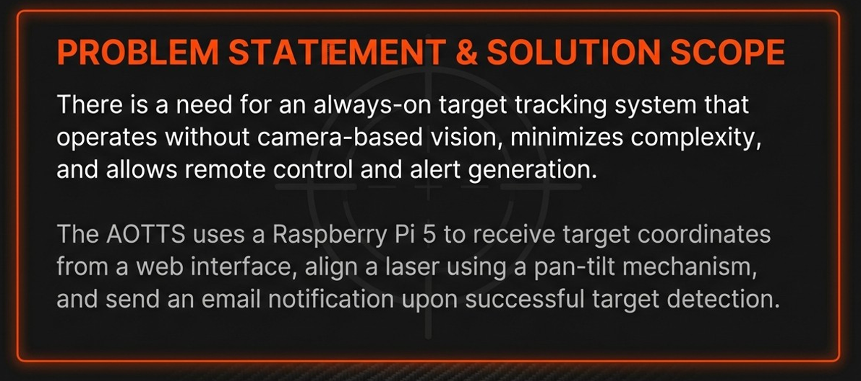

Slide 5
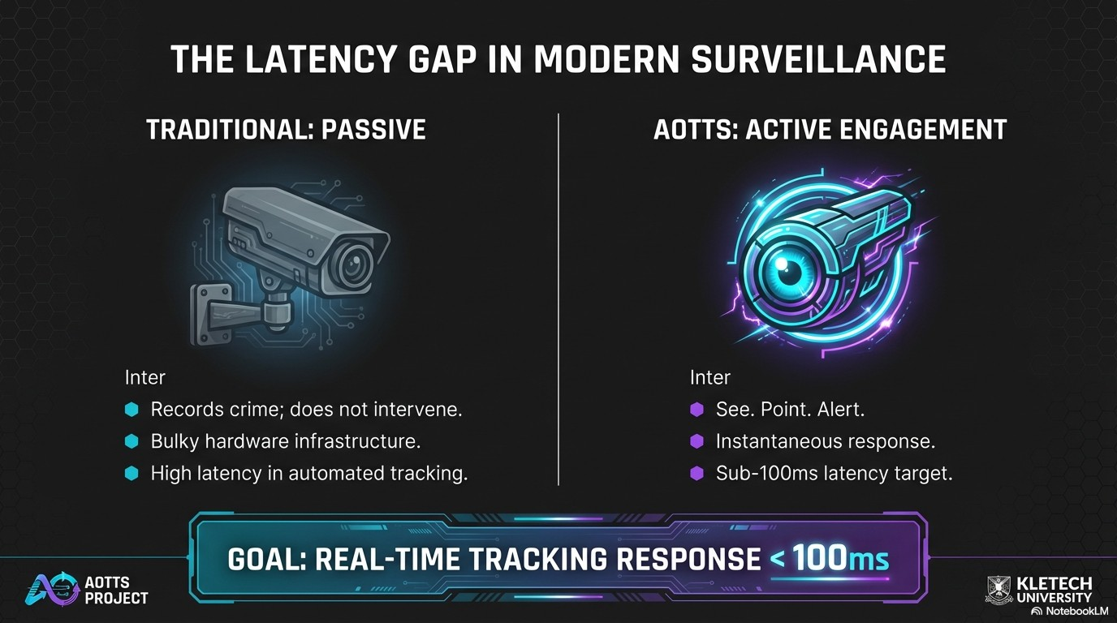



Slide 6
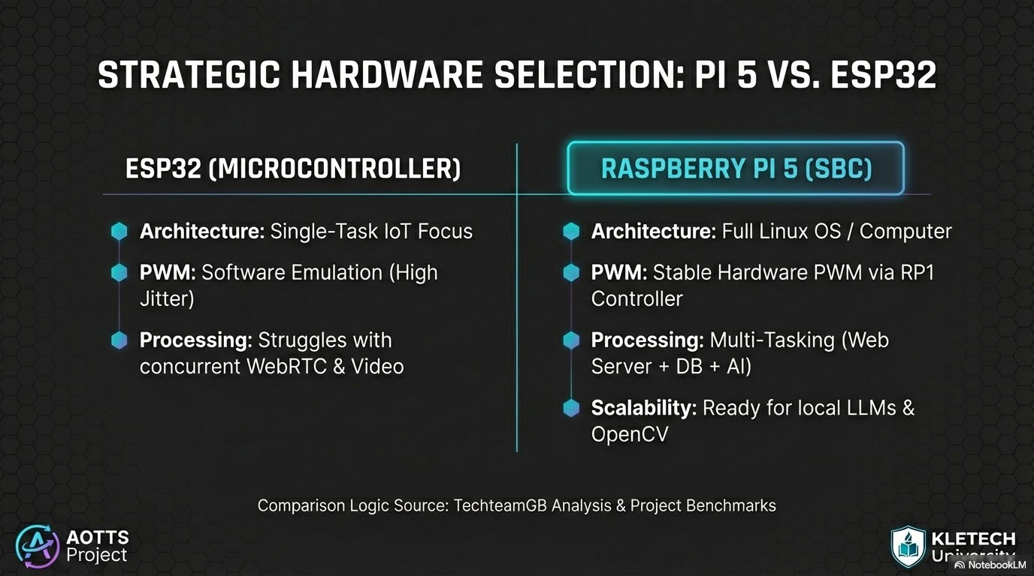

Slide 7
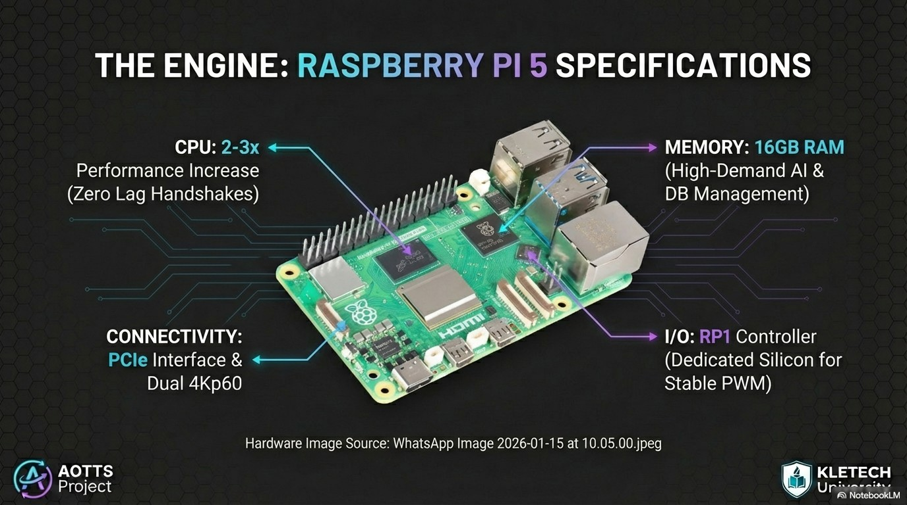


Slide 8
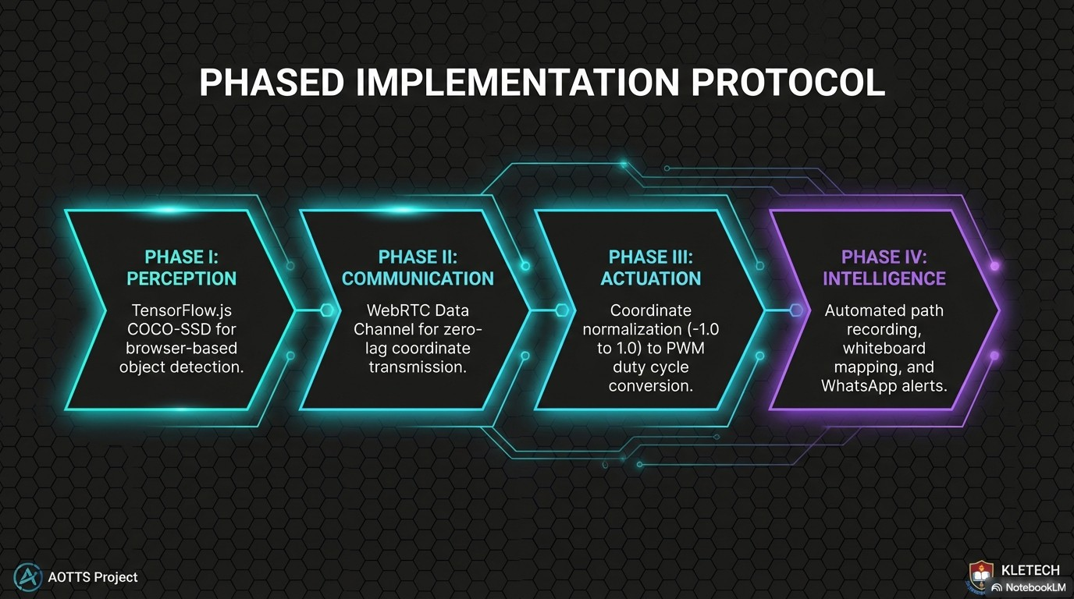

Slide 9
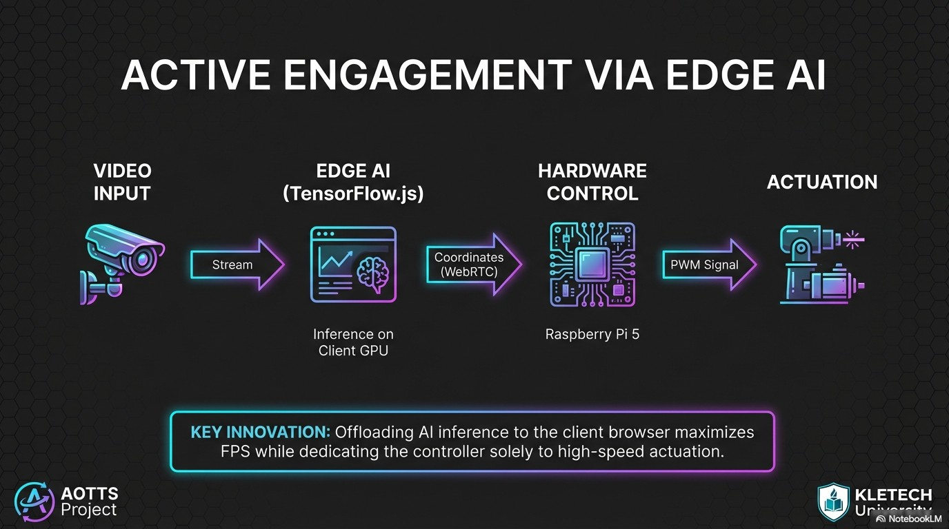

Slide 10
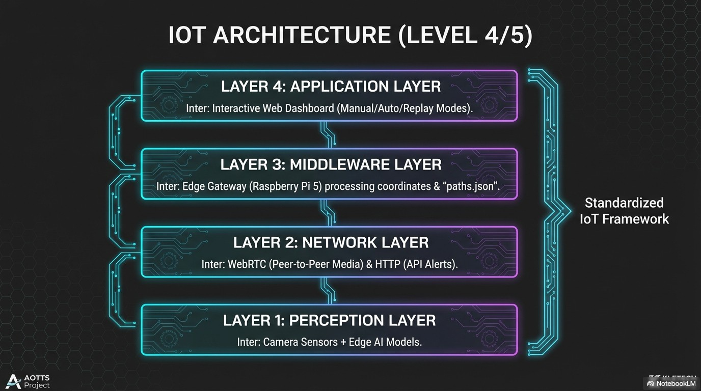


Slide 11
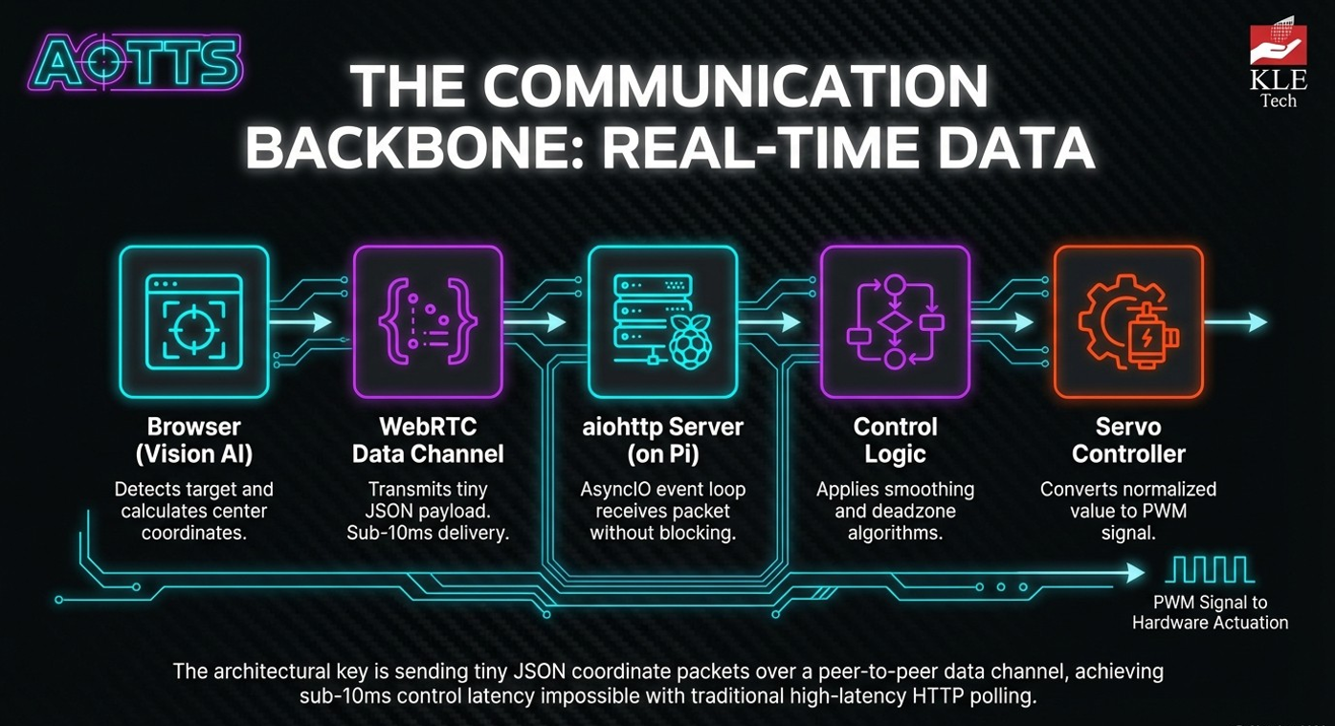




Slide 12
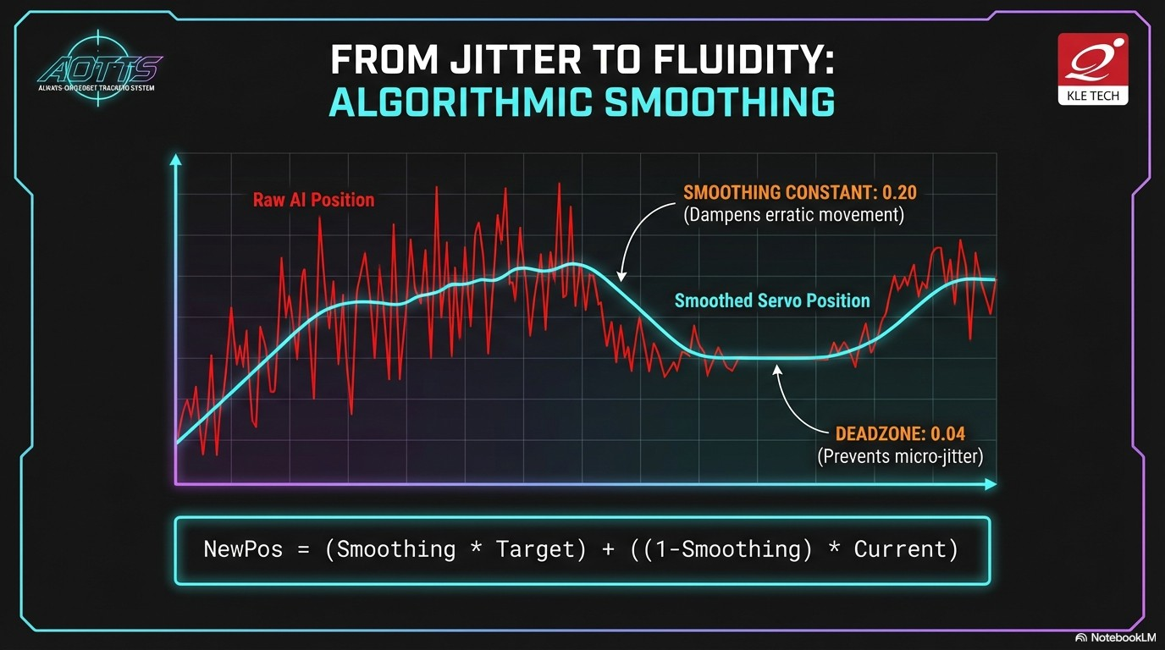

Slide 13
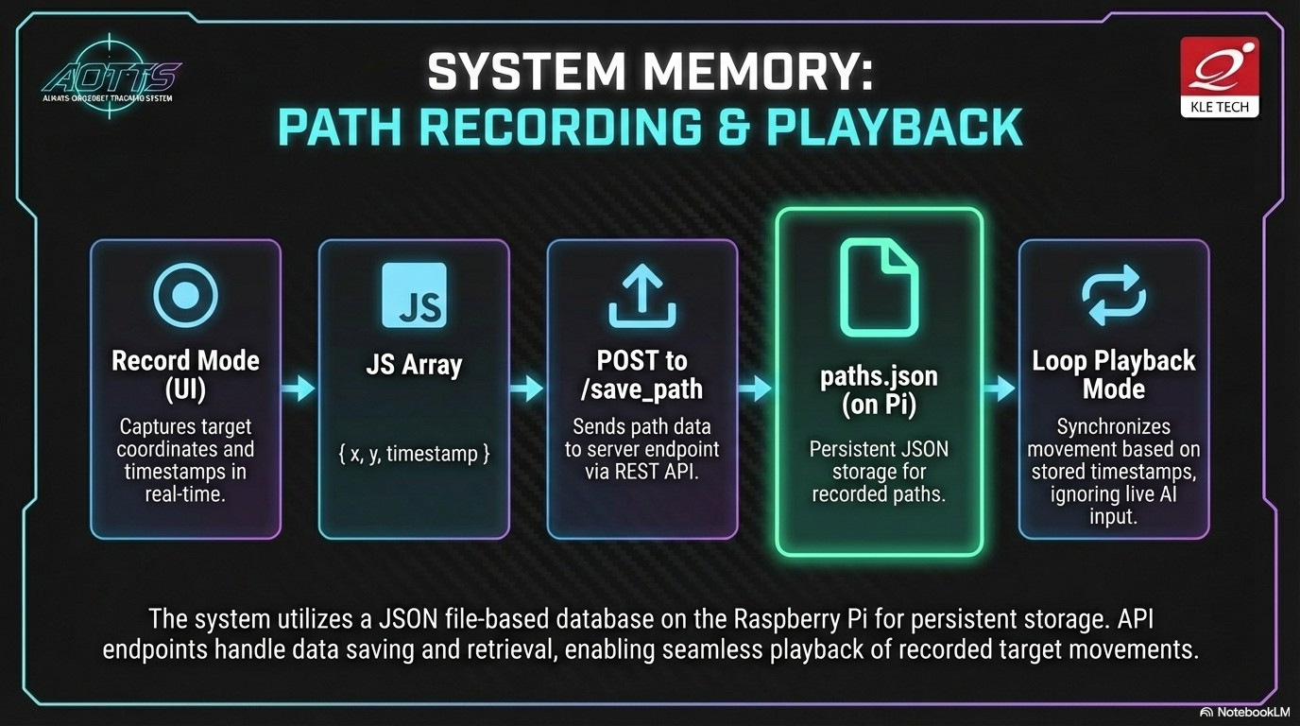

Slide 14
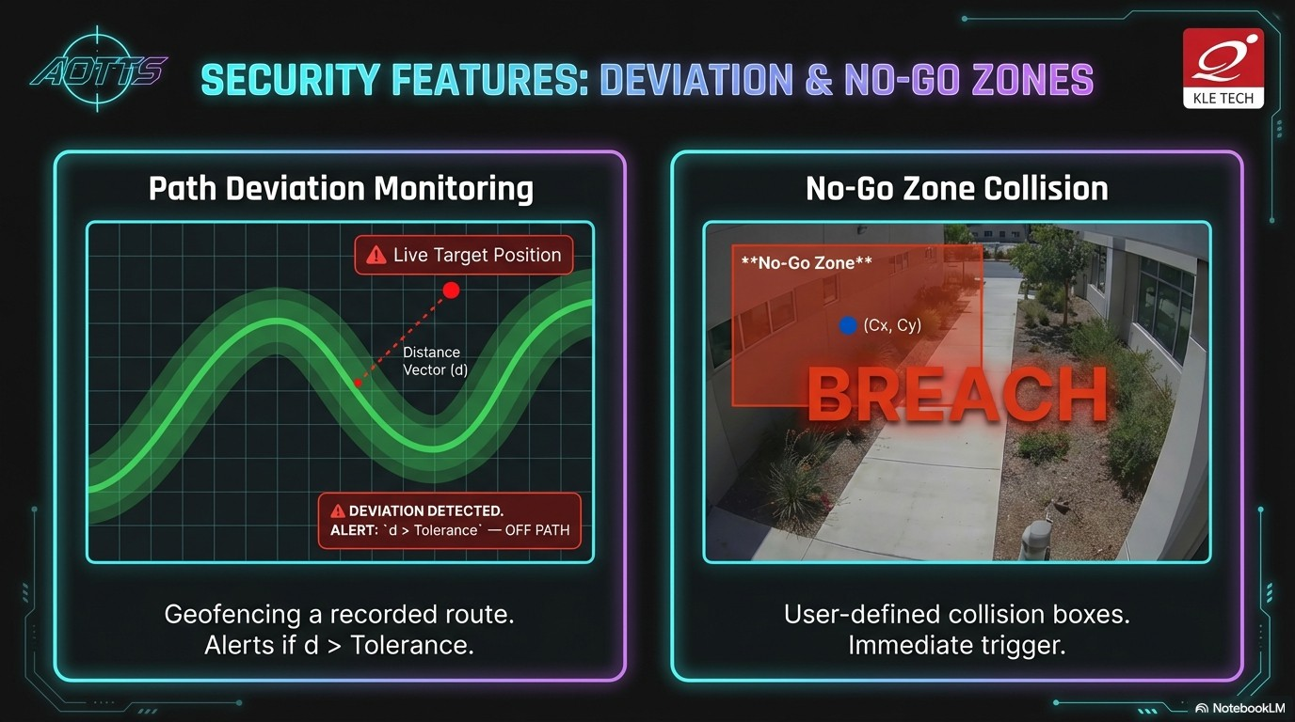

Slide 15
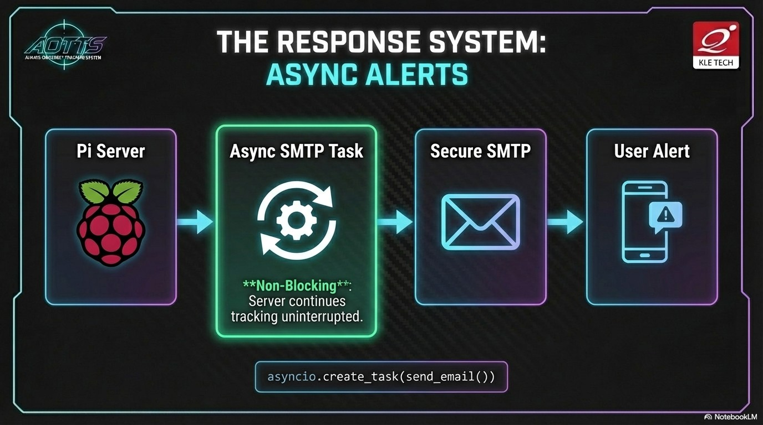

Slide 16
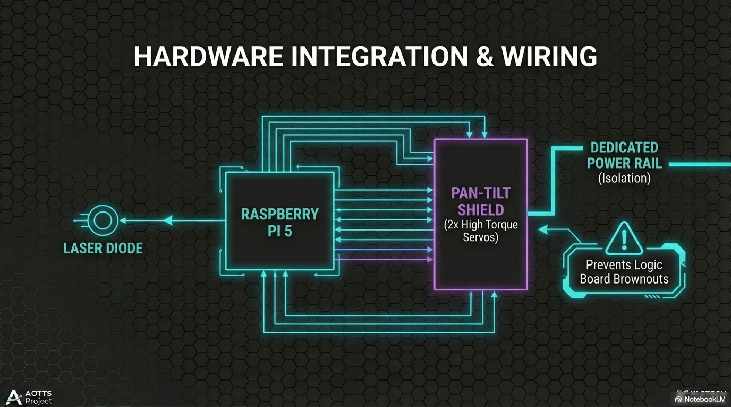
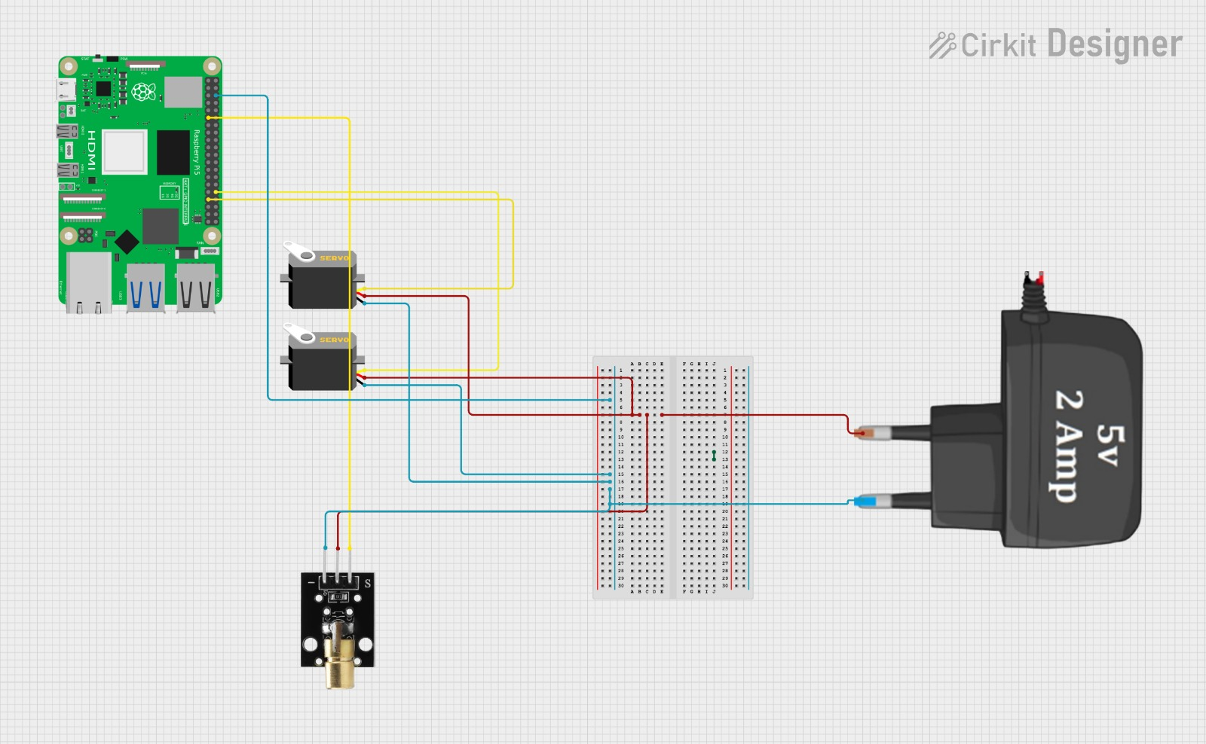


Slide 17
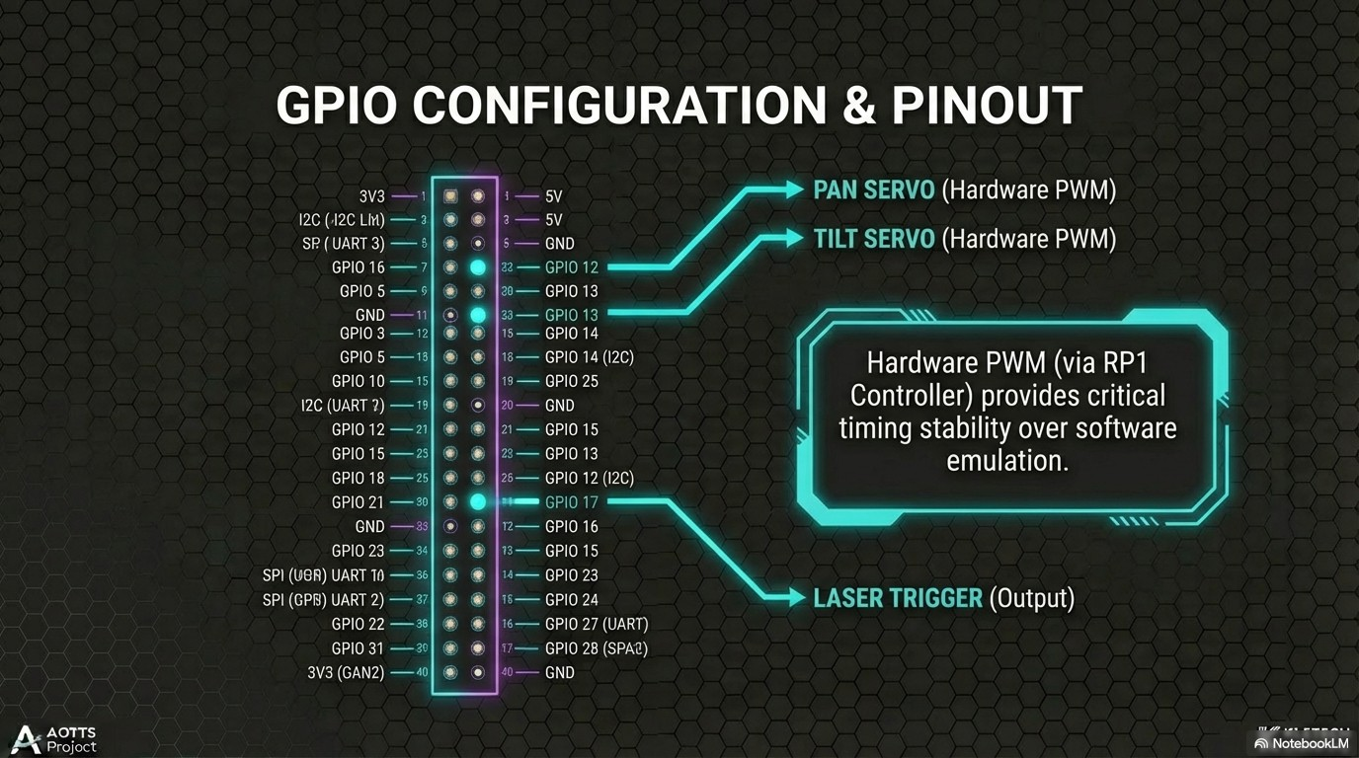

Slide 18
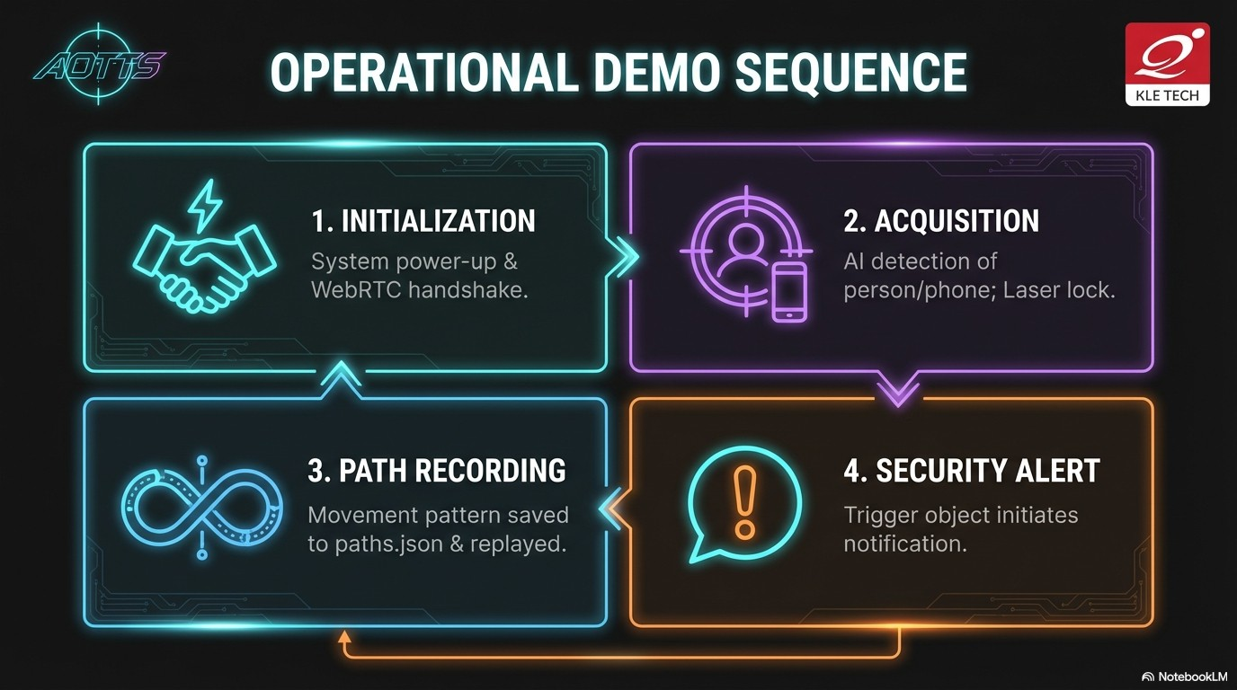

Slide 19
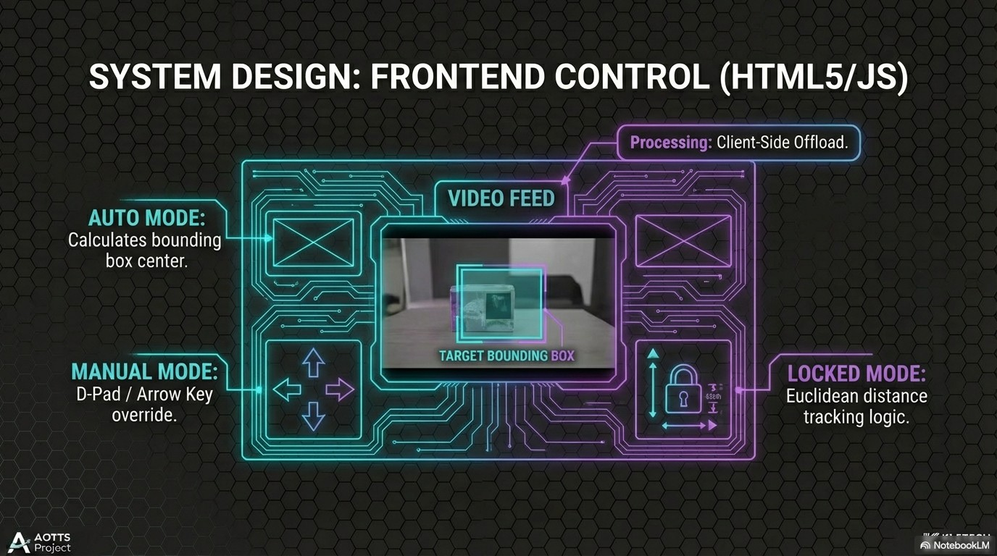

Slide 20
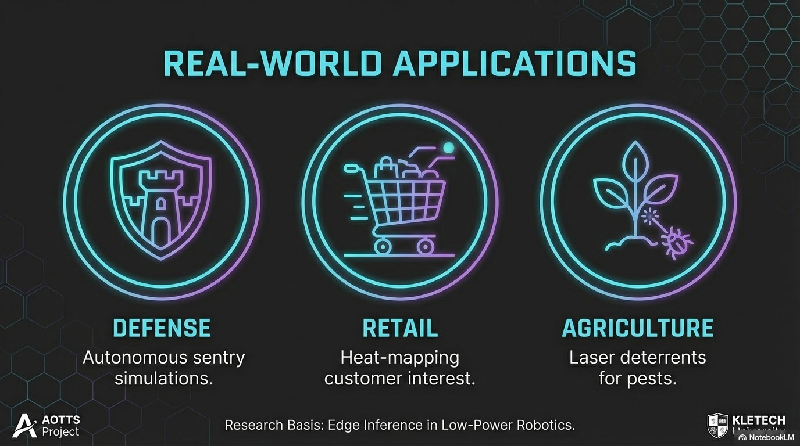


Slide 21
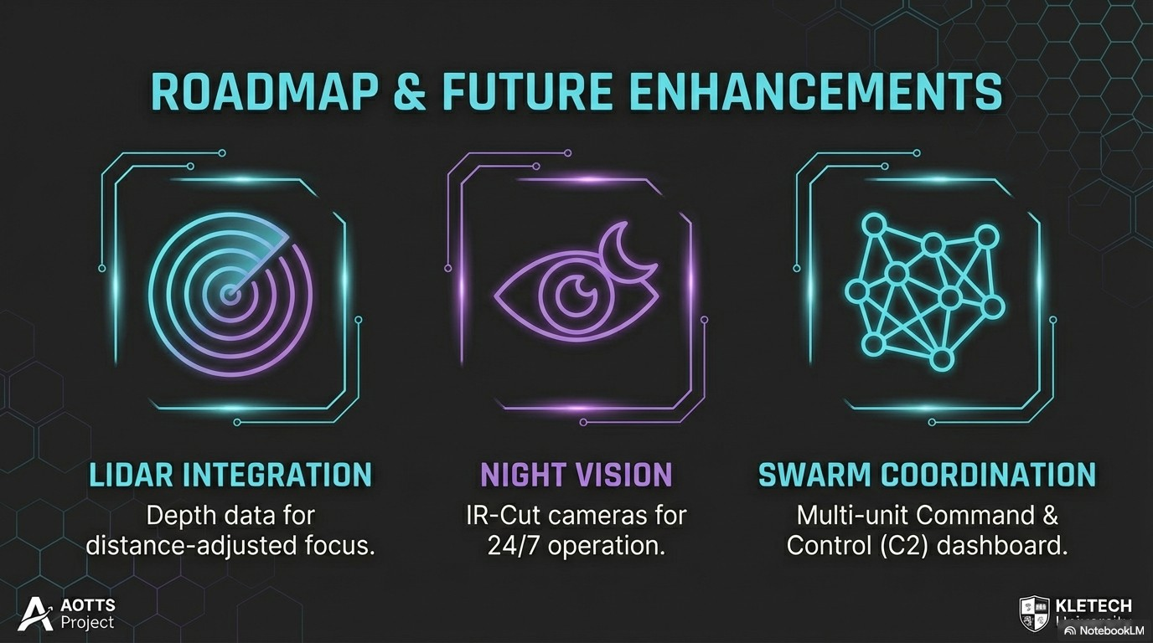

Slide 22
RESEARCH PAPERS -
Artificial Intelligence Based Computer Vision For Virtual Fencing Security System.
A Real-Time Target Tracking and Identification System using Raspberry Pi and OpenCV
IoT-Based Intelligent Surveillance System with Real-Time Alerting and Monitoring
Low-Latency Video Streaming and Data Communication for Robotics via WebRTC
Virtual Fencing and Vision-Based Safety Corridors for Human-Robot Collaboration

Slide 23



